Slide 1
FIFA World cup 1930-2014
Presented By-
Kakul Gupta

Slide 2
Problem Statements Dashboard Part1
Which country host FIFA world cup maximum times.
Which country win FIFA world cup Maximum time.
In which year maximum goals achieved.
In which year maximum audience achieved.
For selected year number of matches happen in which stadiums.
For selected year number of matches happen in which cities.
Referee's for selected year.
Assistant1 Referee's for selected year.
Assistant2 Referee's for selected year.
Stadium with highest number of average attendance.
Total goals by country as Home team for selected year.
Total goals by country as Away team for selected year.
Audience for selected year and match date.
Goals by country for selected year and match date.
Stadium for selected year and date of match date.
City for selected year and date of match date.
Referee for selected year and date of match date.
Source of data:-https://www.kaggle.com/abecklas/fifa-world-cup

Slide 3
Problem Statements Dashboard Part 2
Total audience for selected year.
Max audience in a single match for selected year.
Total Goals for selected year.
Match played Vs goals for selected year.
Golden Ball winner for selected year.
Golden Boot winner for selected year.
Golden Gloves winner for selected year.
Red Card Vs Yellow card for selected year.
Host country for selected year.
Runner-up country for selected year.
Winner country for selected year.
Total number of matches played for selected year.
Total qualified teams for selected year.
Source of data:-https://www.kaggle.com/abecklas/fifa-world-cup

Slide 4
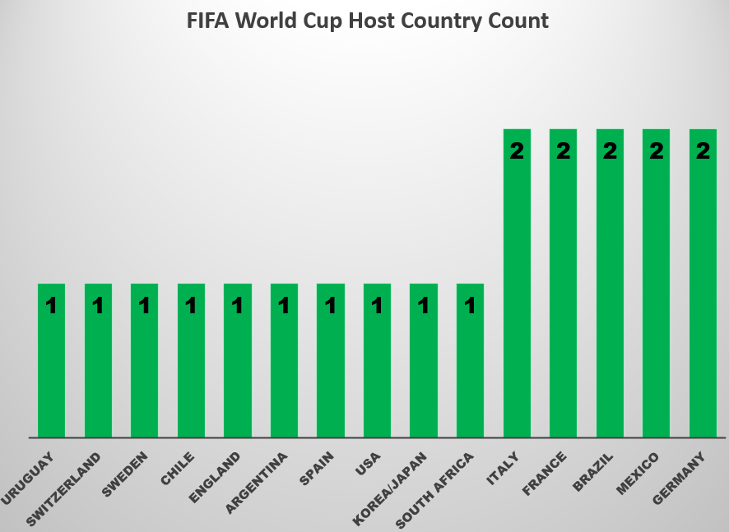
Which country host FIFA world cup maximum times.
With the help of this graph we can easily get Germany, Mexico, Brazil, France, Italy host the FIFA world cup Maximum times i.e. 2.

Slide 5
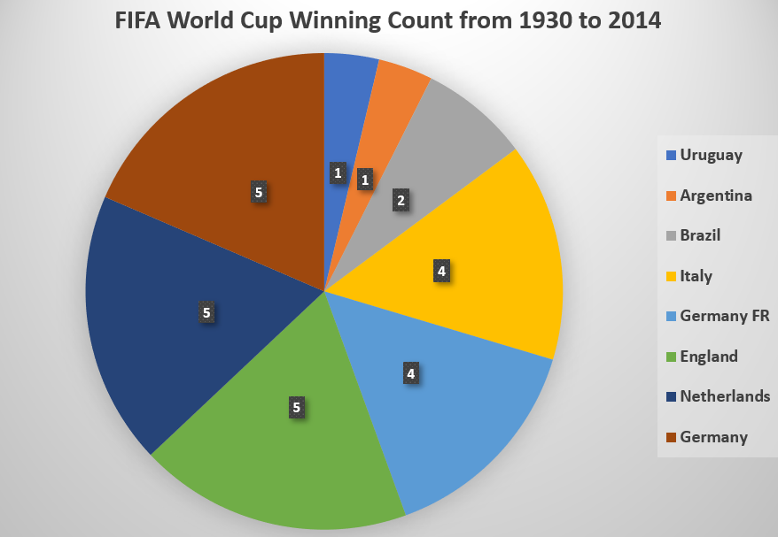
Which country win FIFA world cup Maximum times.
Germany and Netherlands win world cup Maximum times i.e. 5.

Slide 6
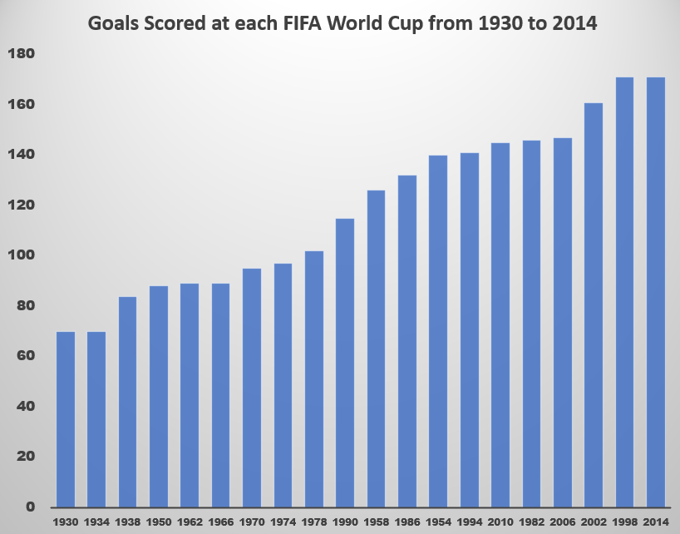
In which year maximum goals achieved.
In 1998 and 2014 maximum goals achieved i.e. 171 goals.

Slide 7
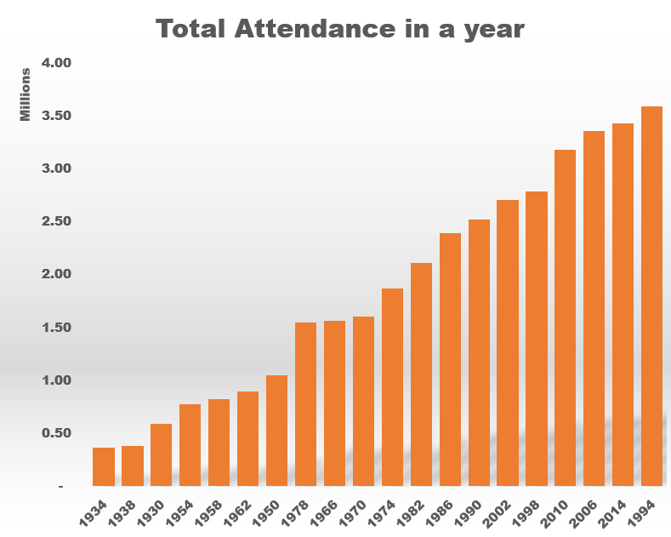
In which year maximum audience achieved.
In 1994 we have max audience i.e. 3.59 Millions.

Slide 8
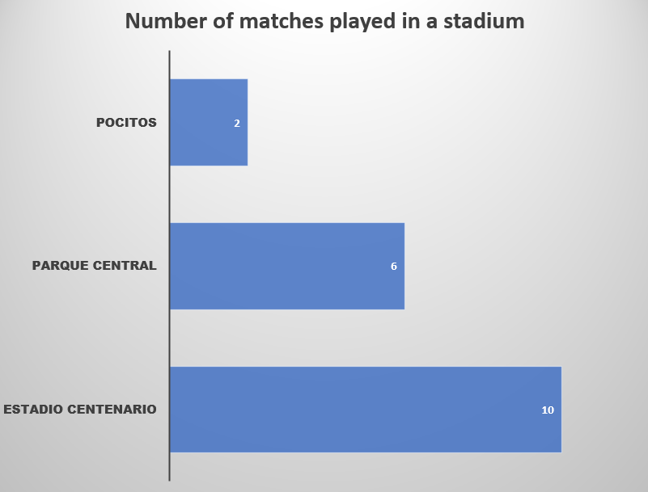
For selected year number of matches happen in which stadiums.
This graph is for year 1930 we can easily get 18 matches happen in year 1930 .
2 Matches happened in POCITOS stadium.
6 Matches happened in PARQUE CENTRAL stadium.
10 Matches happened in ESTADIO CENTENARIO stadium.

Slide 9
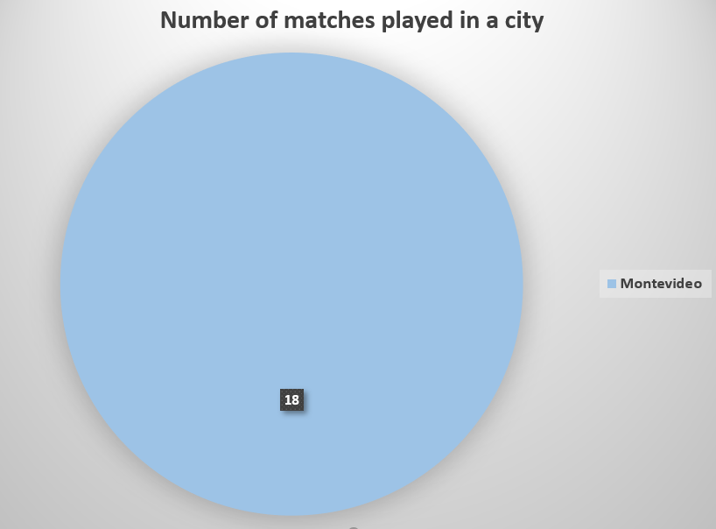
For selected year number of matches happen in which cities.
This graph is for year 1930 we can easily get all 18 matches happened in only one city i.e. Montevideo.

Slide 10
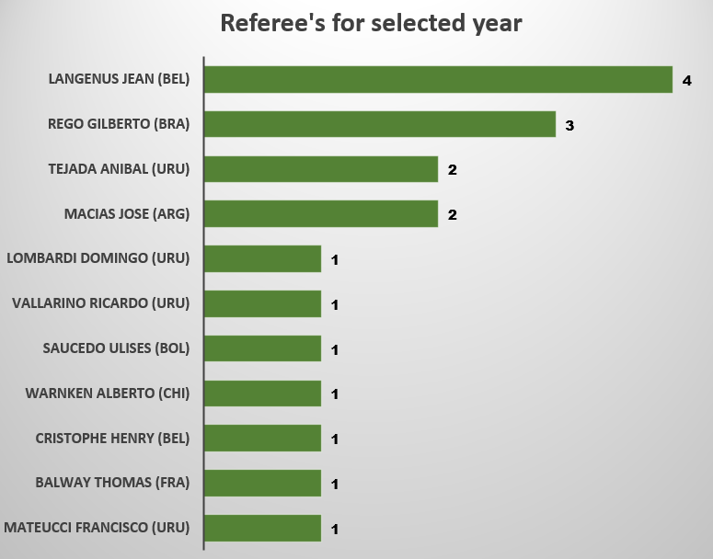
Referee's for selected year.
This graph is for year 1930 we can easily get below are the Referee’s for this year.
LOMBARDI Domingo (URU)
MACIAS Jose (ARG)
TEJADA Anibal (URU)
WARNKEN Alberto (CHI)
REGO Gilberto (BRA)
CRISTOPHE Henry (BEL)
MATEUCCI Francisco (URU)
LANGENUS Jean (BEL)
SAUCEDO Ulises (BOL)
BALWAY Thomas (FRA)
VALLARINO Ricardo (URU)

Slide 11
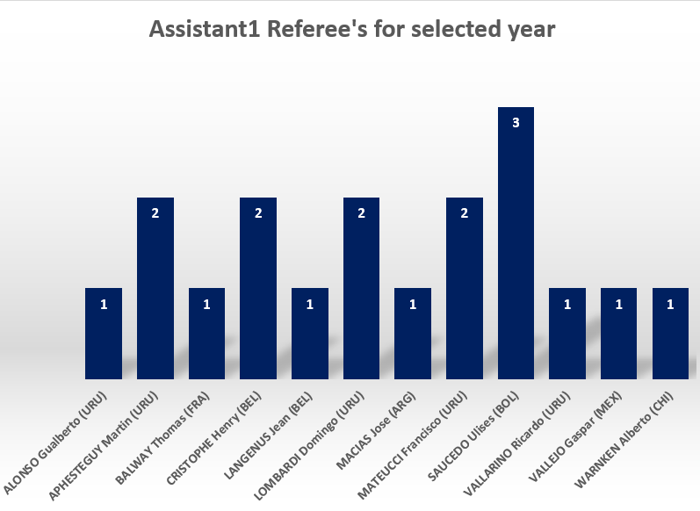
Assistant1 Referee's for selected year.
This graph is for year 1930 we can easily get below are the Assistant1 Referee’s for this year.
CRISTOPHE Henry (BEL)
MATEUCCI Francisco (URU)
VALLARINO Ricardo (URU)
LANGENUS Jean (BEL)
SAUCEDO Ulises (BOL)
APHESTEGUY Martin (URU)
LOMBARDI Domingo (URU)
BALWAY Thomas (FRA)
ALONSO Gualberto (URU)
MACIAS Jose (ARG)
WARNKEN Alberto (CHI)
VALLEJO Gaspar (MEX)

Slide 12
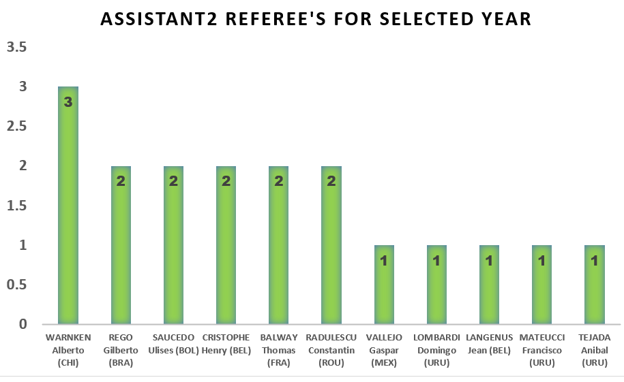
Assistant2 Referee's for selected year.
This graph is for year 1930 we can easily get below are the Assistant2 Referee’s for this year.
REGO Gilberto (BRA)
WARNKEN Alberto (CHI)
BALWAY Thomas (FRA)
MATEUCCI Francisco (URU)
RADULESCU Constantin (ROU)
LANGENUS Jean (BEL)
TEJADA Anibal (URU)
CRISTOPHE Henry (BEL)
VALLEJO Gaspar (MEX)
LOMBARDI Domingo (URU)
SAUCEDO Ulises (BOL)

Slide 13
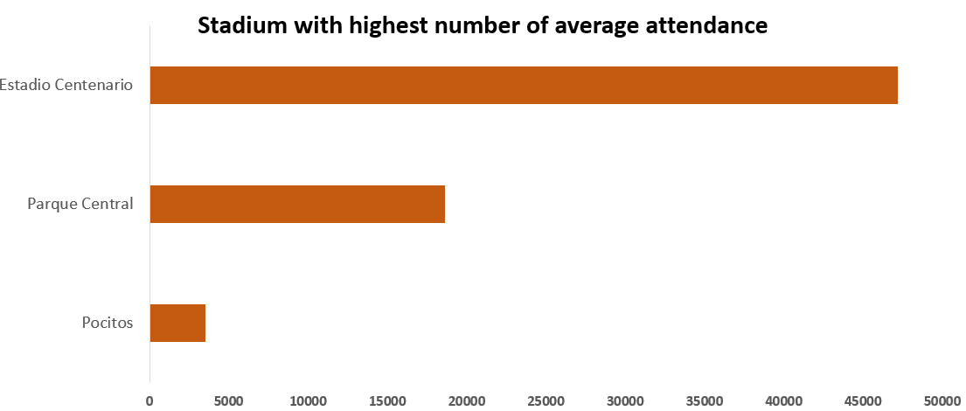
Stadium with highest number of average attendance.
This graph is for year 1930 we can easily get Estadio Centenario stadium has highest average attendance.

Slide 14
Total goals by country as Home team for selected year.
This graph is for year 1930 we can easily get Argentina has highest goals as Home team.

Slide 15
Total goals by country as Away team for selected year.
Last graph is for year 1930 we can easily get Mexico has highest goals as Away team.

Slide 16
Audience for selected year and match date.
This graph is for year 1930. Match date is 13-jul-1930 -15:00.
For this date and time two matches happened one is France vs Mexico and second one is USA vs Belgium.
France vs Mexico audience- 4.44 Thousand
USA vs Belgium audience- 18.35 Thousand

Slide 17
Goals by country for selected year and match.
This graph is for year 1930. Match date is 13-jul-1930 -15:00.
For this date and time two matches happened one is France vs Mexico and second one is USA vs Belgium.
This graph show us in France vs Mexico France hit more goals as compare to Mexico. So France is win team for this match.
This graph show us in USA vs Belgium USA hit more goals as compare to Belgium. So USA is win team for this match.

Slide 18
Stadium for selected year and match date.
This graph is for year 1930. Match date is 13-jul-1930 -15:00.
For this date and time two matches happened one is France vs Mexico and second one is USA vs Belgium.
This graph show us in France vs Mexico match happened in Pocitos stadium.
This graph show us in USA vs Belgium match happened in Parque Central stadium.

Slide 19
City for selected year and match date.
This graph is for year 1930. Match date is 13-jul-1930 -15:00.
For this date and time two matches happened one is France vs Mexico and second one is USA vs Belgium.
This graph show us in France vs Mexico and USA vs Belgium happened in same city Montevideo.

Slide 20
Referee’s for selected year and match date.
This graph is for year 1930. Match date is 13-jul-1930 -15:00.
For this date and time two matches happened one is France vs Mexico and second one is USA vs Belgium.
This graph show us in France vs Mexico and USA vs Belgium happened in same city Montevideo.

Slide 21
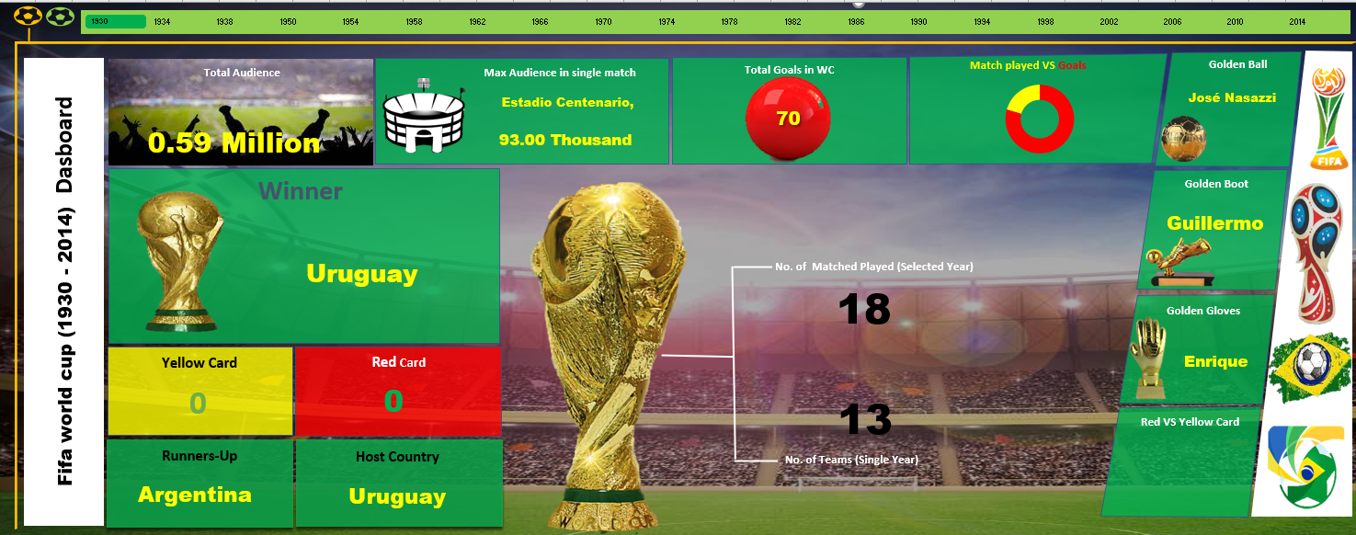
Dashboard Part 2
Here we can check few more point for selected year.
Golden Ball winner
Golden Boot Winner
Golden Gloves Winner
Red card vs Yellow Card
Host Country
Runner-up Country
Winner
No. of qualified teams
No. of Matched played

Slide 22
Conclusion
This Dashboard will help you to get information about FIFA world cup 1930 to 2014.
We can get summary for FIFA world by year.
Also we can get some information about matches for every year.

Slide 23
Thank You!

